Slide 1






Senior Design Project:
Cognitive Assistance with LiDAR
Localization (C-ALL)
Preliminary Demo
Ahmad Shah, Neeti Mistry, Sara Gaber & Sohan Chatterjee
Notes:
THURSDAY FEB 20
Ahmad: 19-20, 25-30
Neeti: 1-9
Sara: 21-24, 13-15
Sohan: 10-12, 16-18

Slide 2



Introduction
Overview of Project

Slide 3

Introduction
Objective: Develop an affordable, real-time navigation system for visually impaired individuals
Utilizing LiDAR technology integrated into newer iPhone Pro models for real-time navigation
Technology Stack: LiDAR, Swift, Geographical ARKit, Bluetooth, Raspberry Pi, Mobile Application (iOS), SolidWorks
Key Features:
Real-time obstacle detection and path guidance
Integration between hardware and software
Mapping and navigation on sidewalks rather than roads for improved pedestrian safety
Impact: Enhancing mobility, independence, and accessibility
Started hardware implementation this semester and assembling initial components
Continuing development on codebase, refining obstacle detection and path guidance

Slide 4
List of Requirements
Mapping requirements to use cases

Slide 5
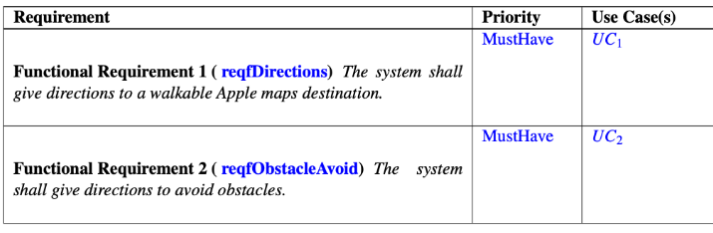
User Requirements

Slide 6
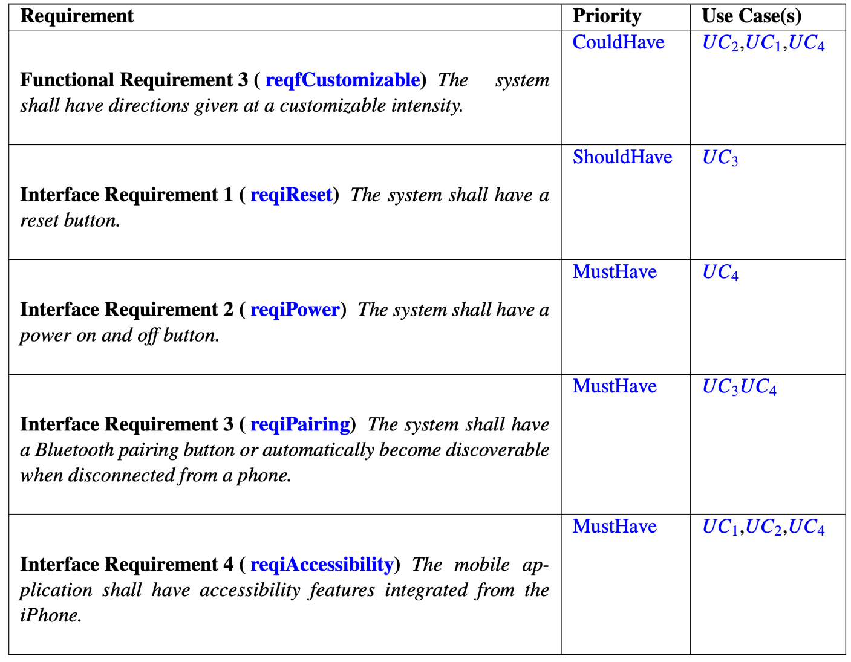
User Requirements

Slide 7
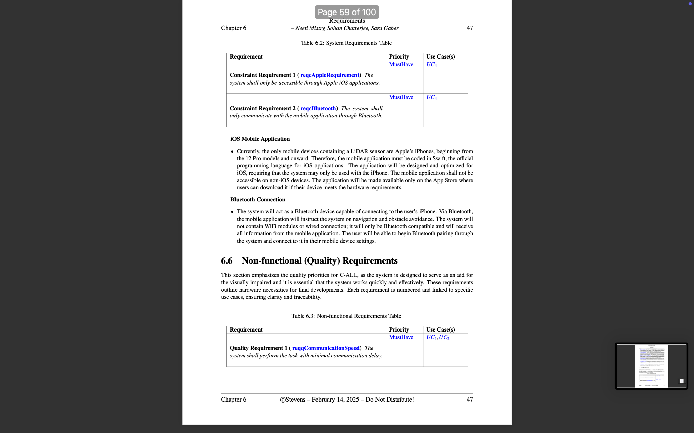
System (Constraints) Requirements

Slide 8
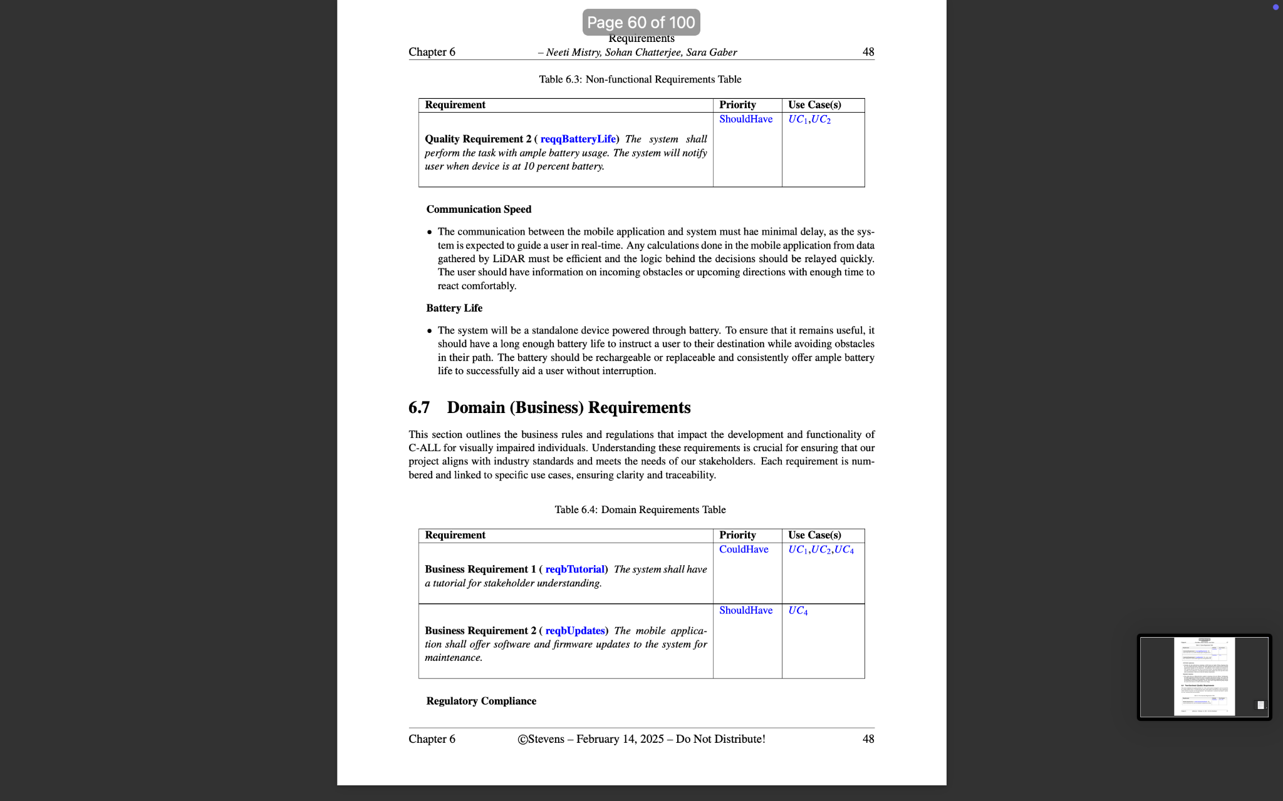
Non-Functional (Quality) Requirements

Slide 9
Domain (Business) Requirements

Slide 10
Use Case Diagram
Updated use case diagram and table

Slide 11
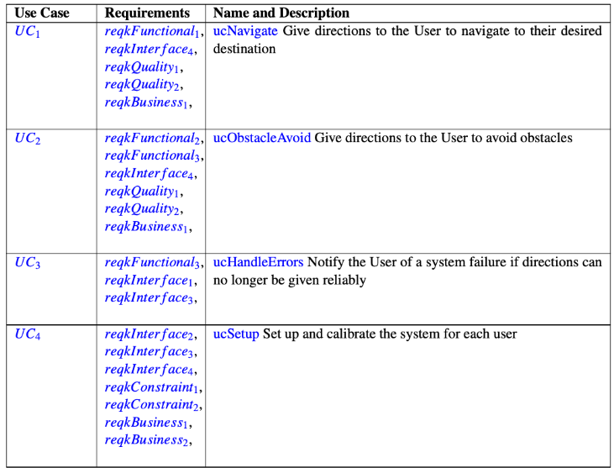
Table of Use Cases

Slide 12
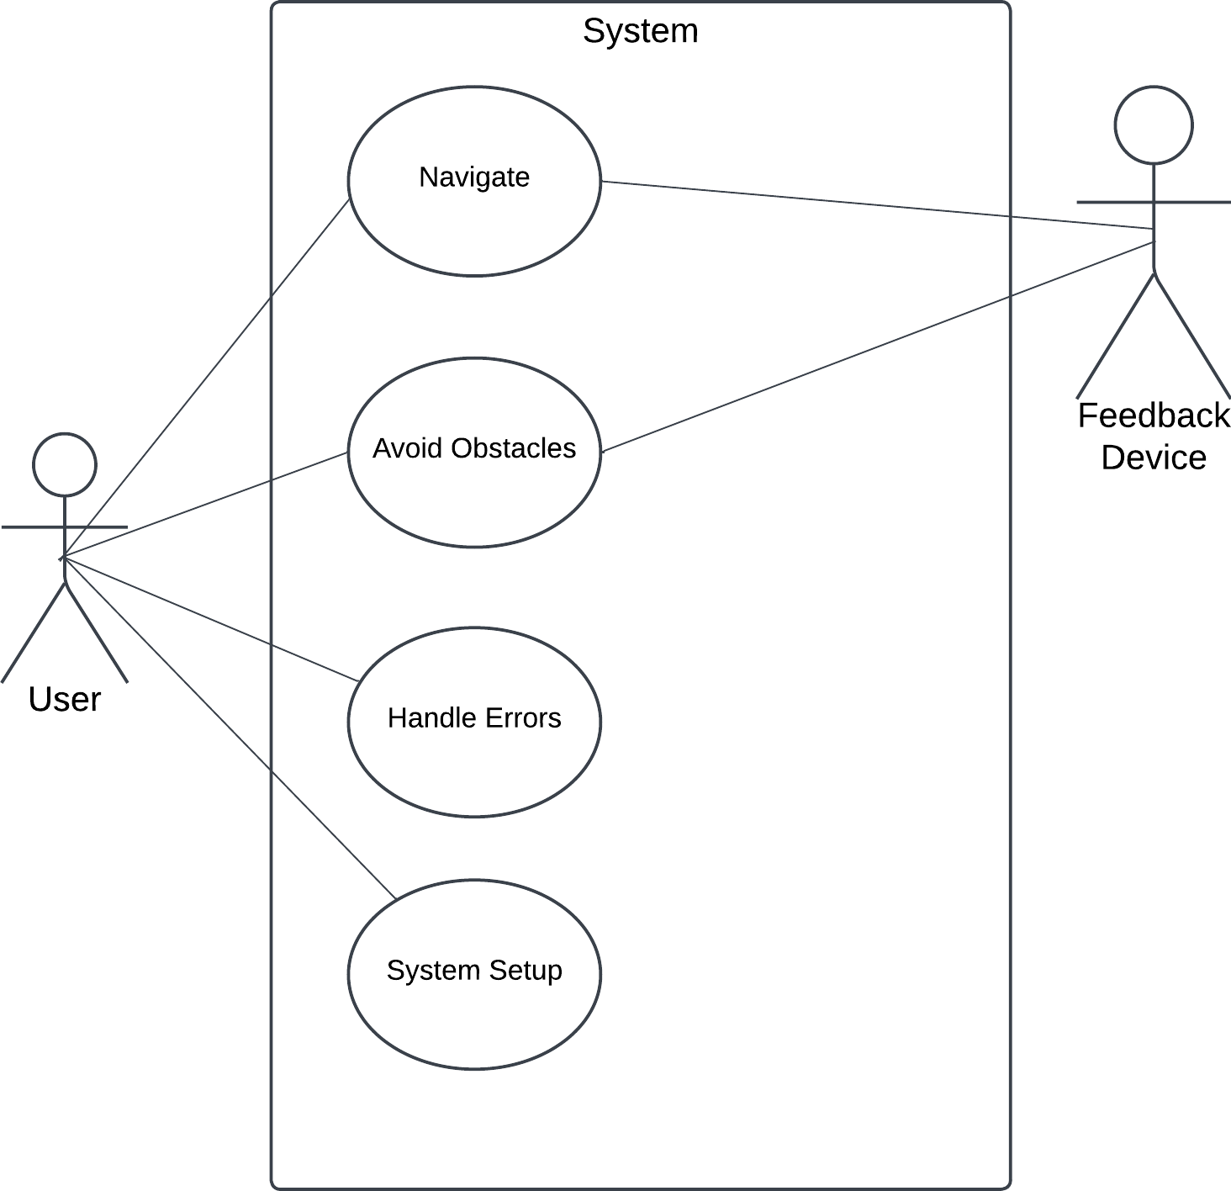
Use Case Diagram

Slide 13
(1) Use Case and Corresponding Activity Diagram
Selected one use case and corresponding activity diagram

Slide 14
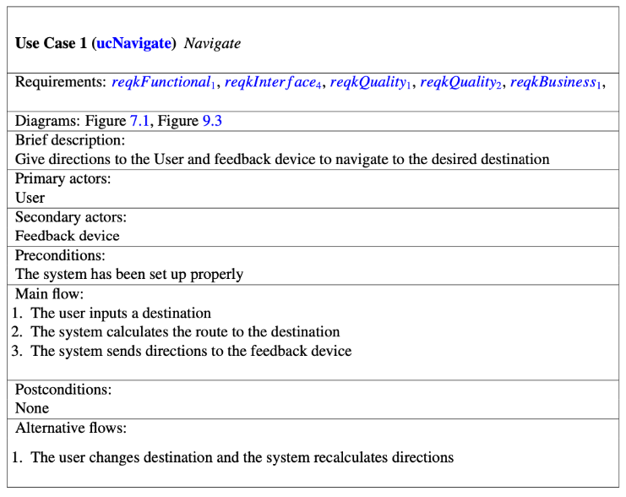
Use Case

Slide 15
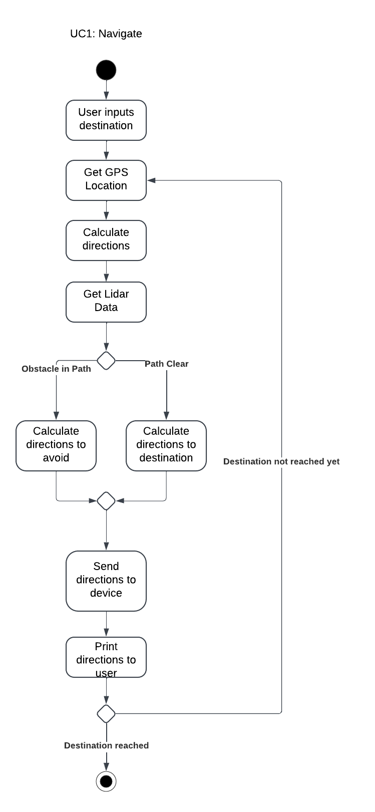
Activity Diagram

Slide 16
Class Diagram and CRC Cards
Mapping every step of activity diagram to at least one class and showing the class' responsibility

Slide 17
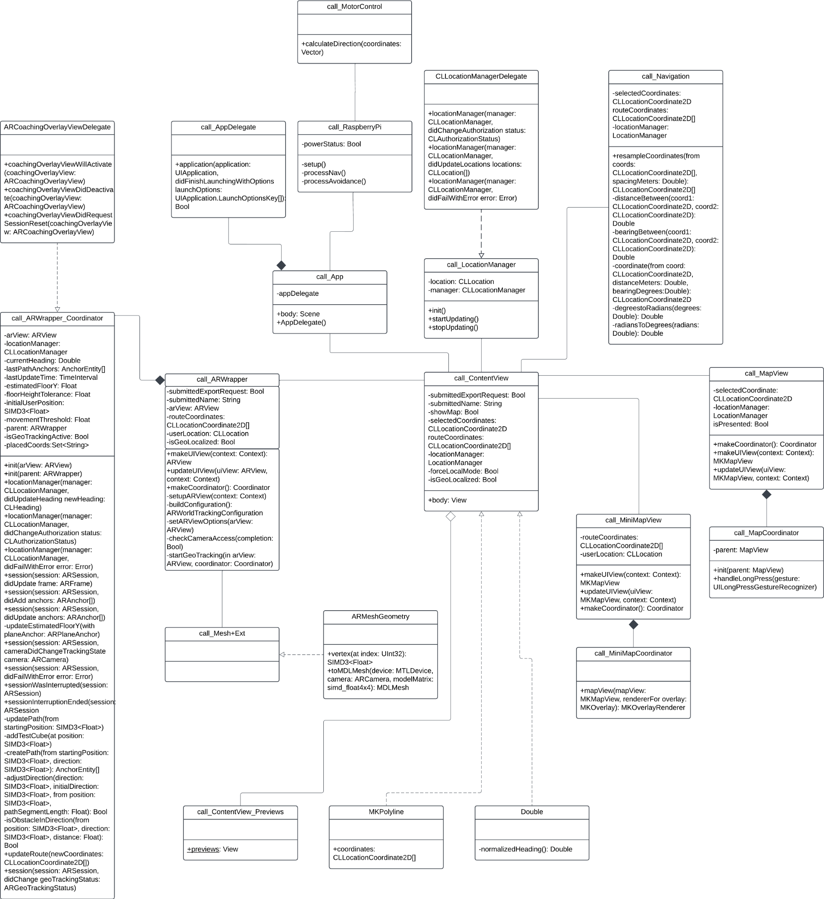
Class Diagram

Slide 18
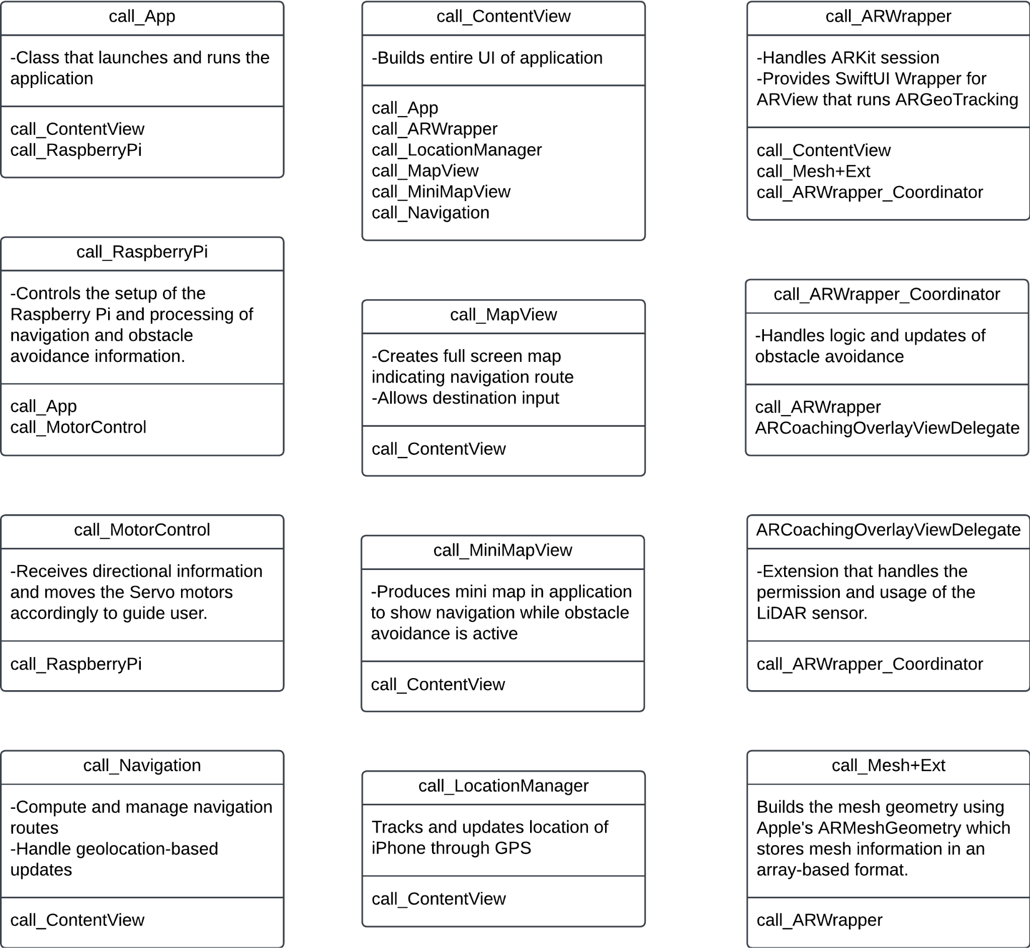
CRC Cards

Slide 19
Live Demos
Current status of the project implementation and testing

Slide 20
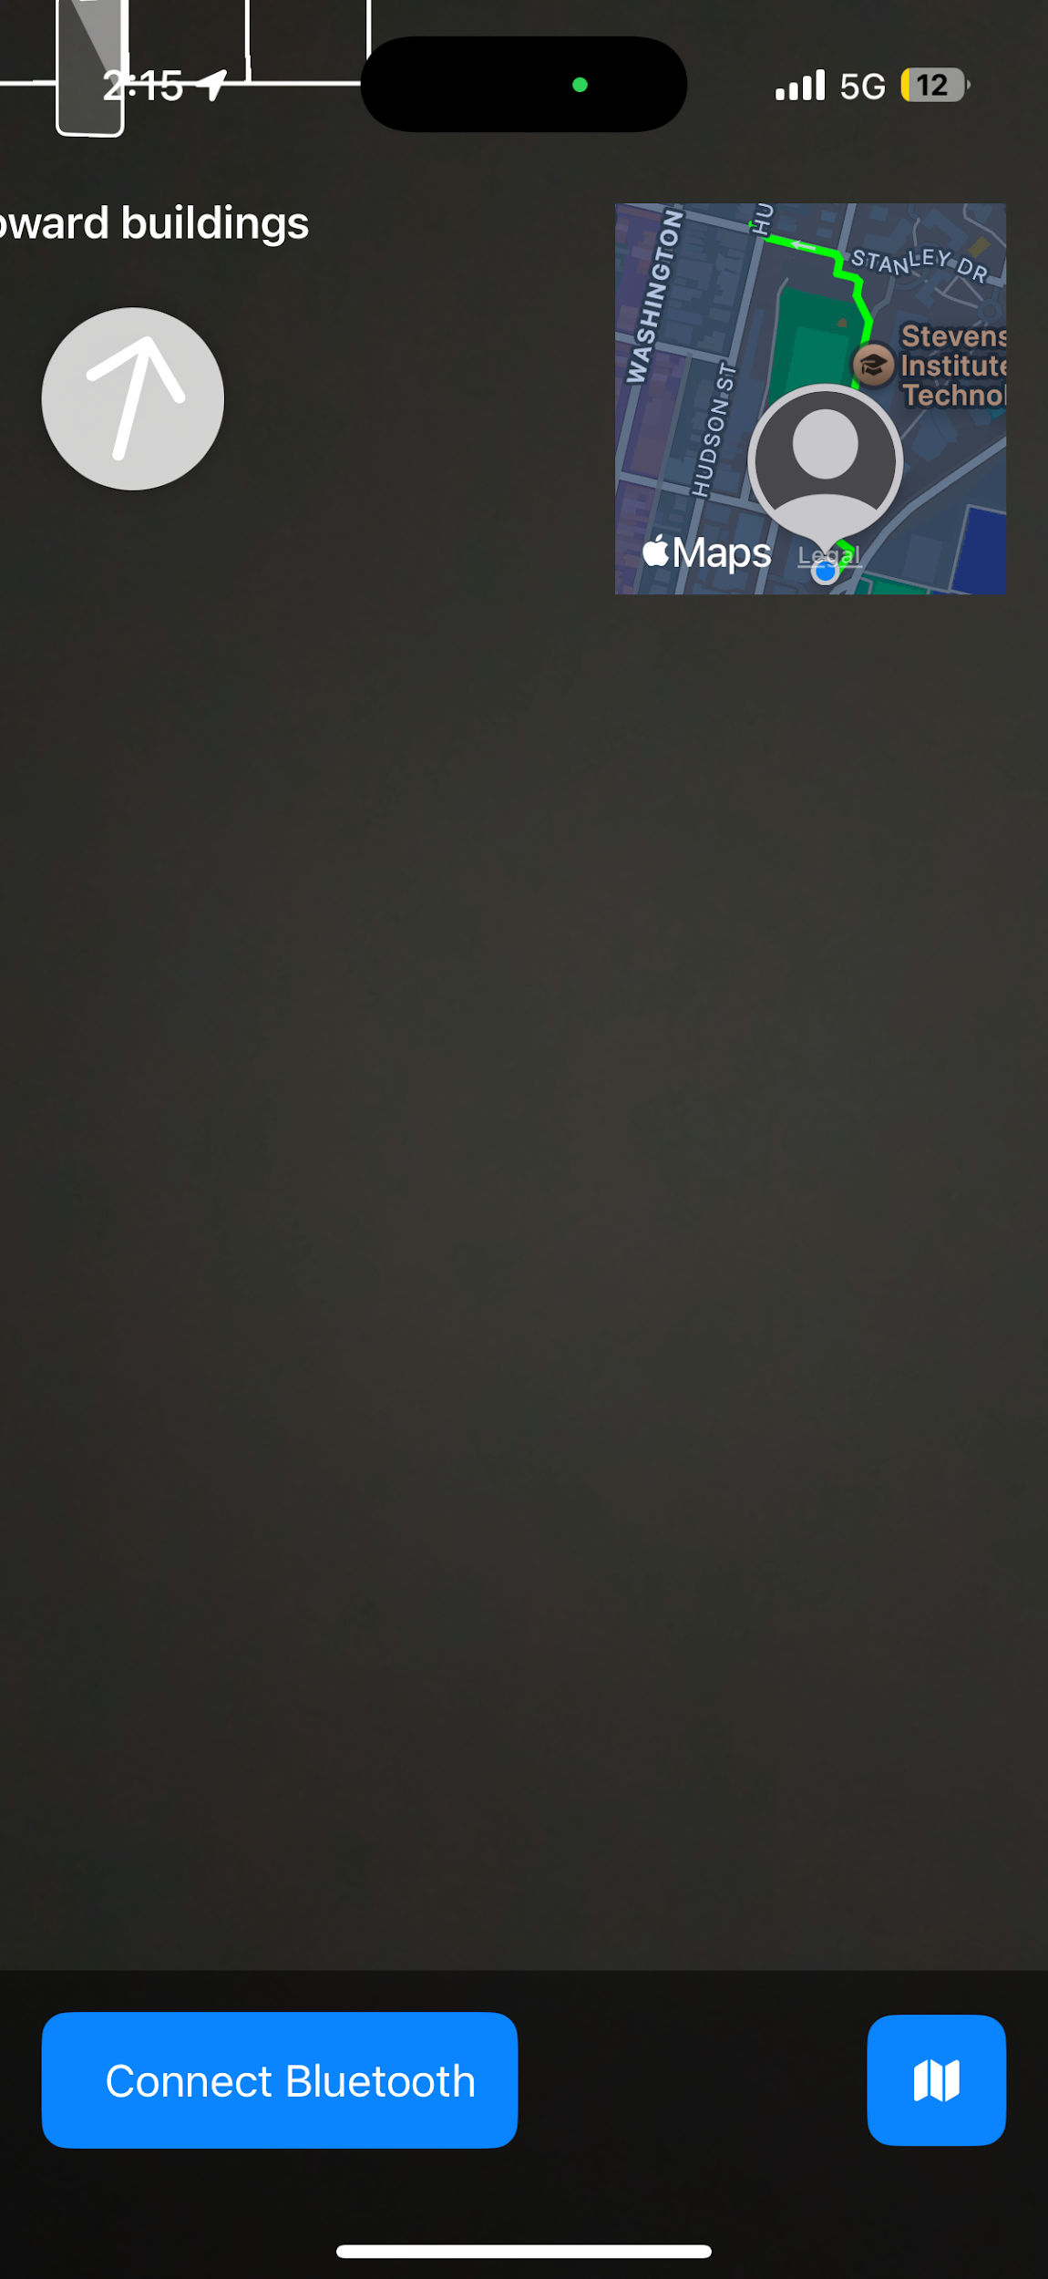
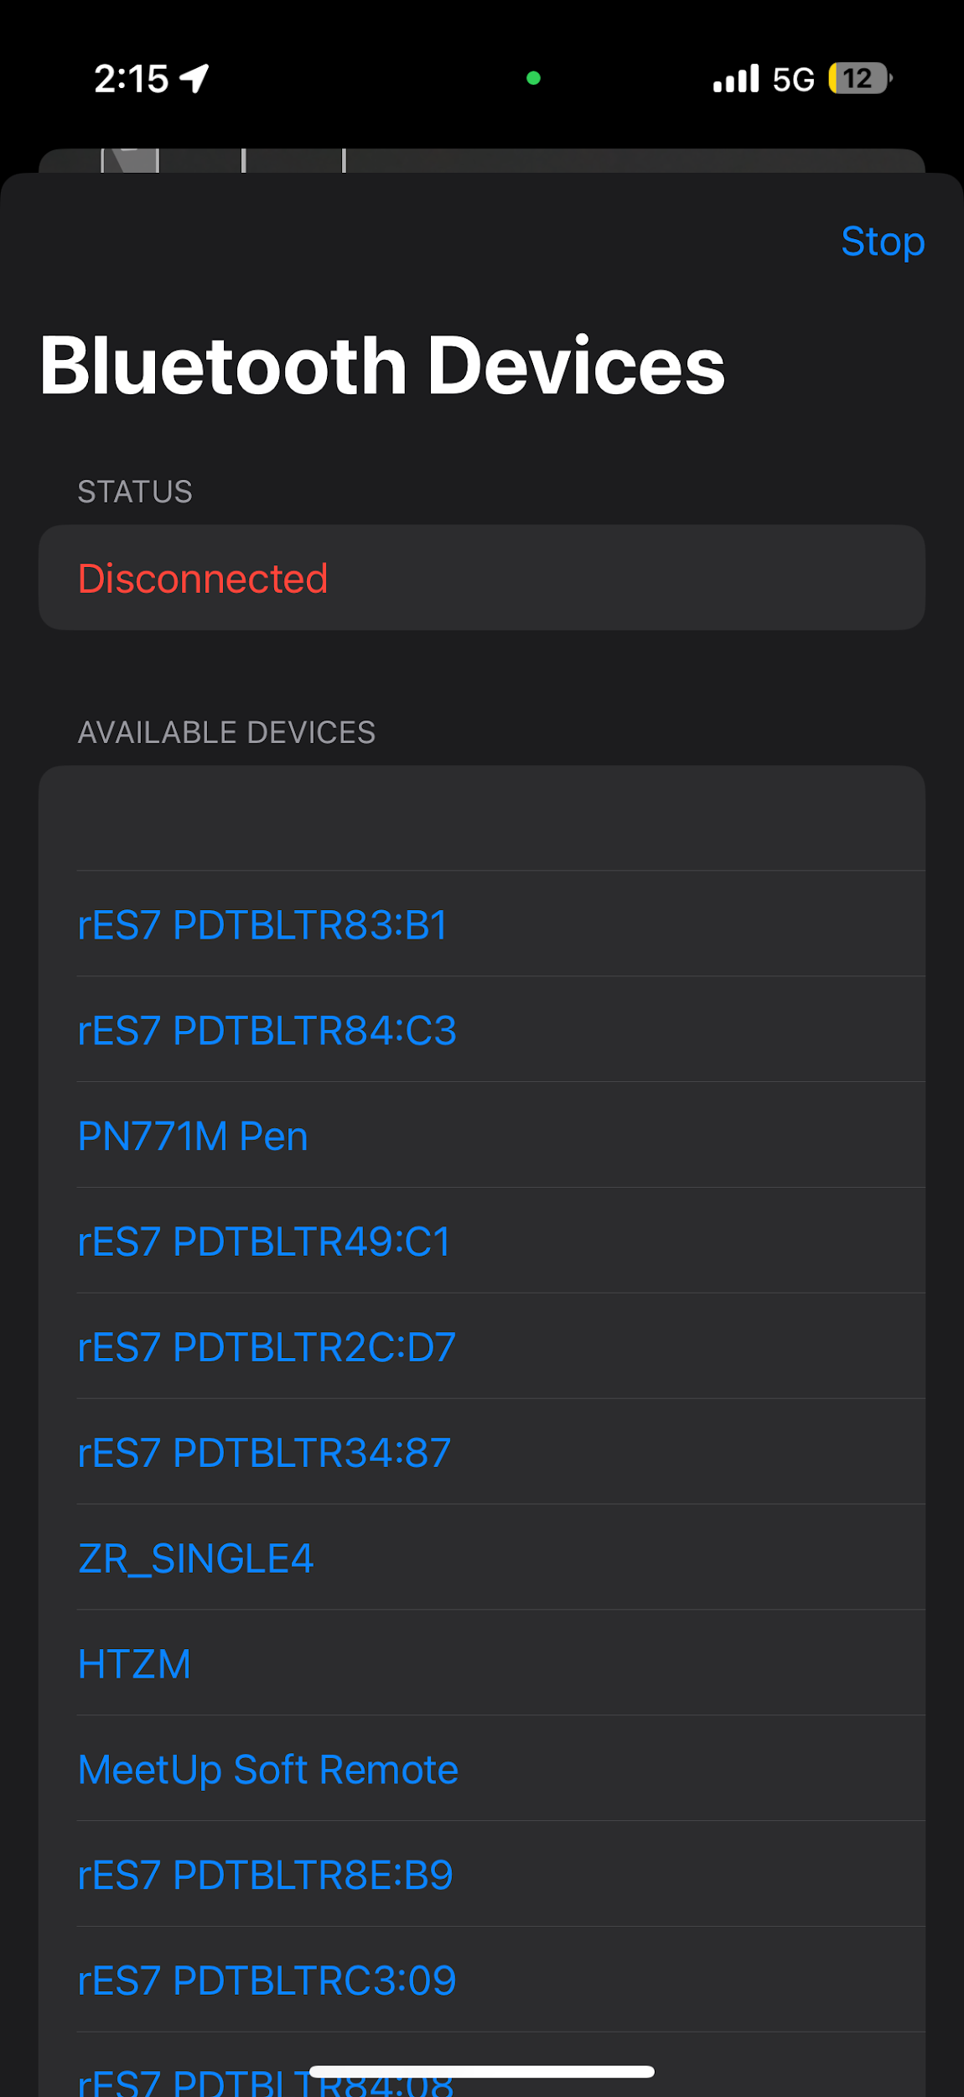
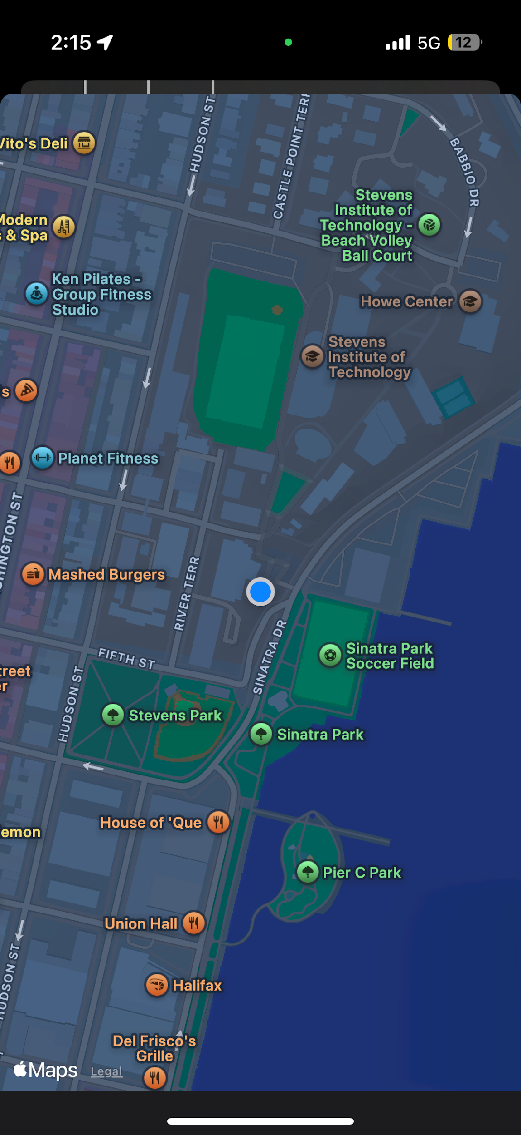
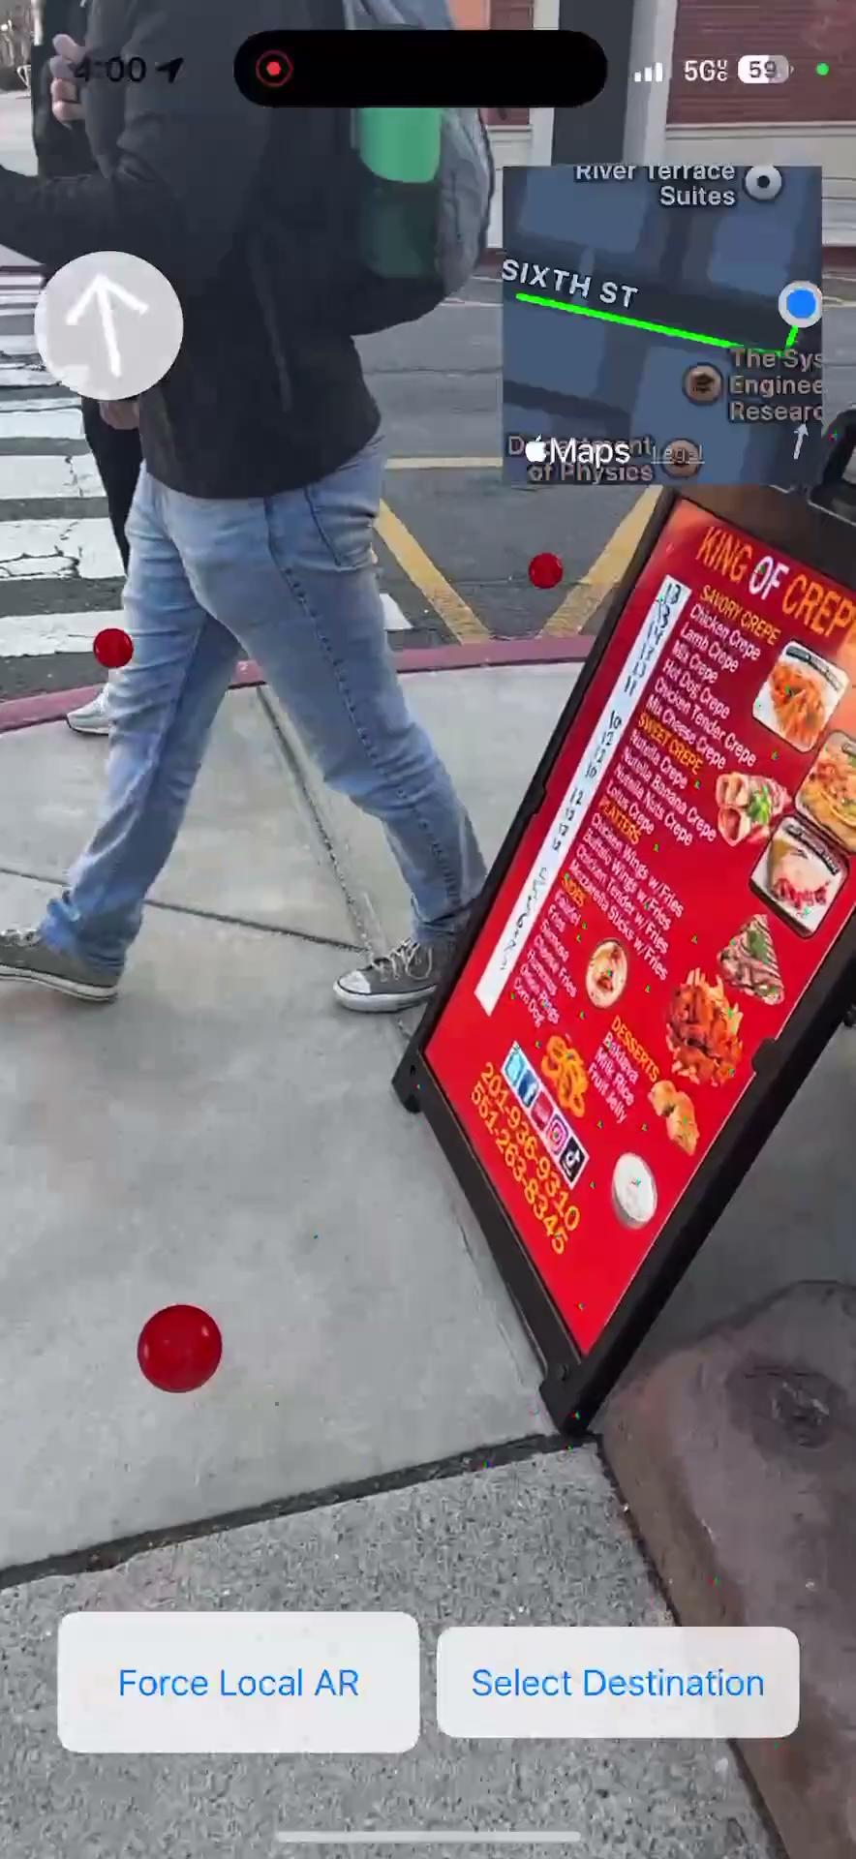
Working Prototype Demos

Slide 21
Hardware Prototype
Solidworks Prototypes and Hardware Materials

Slide 22
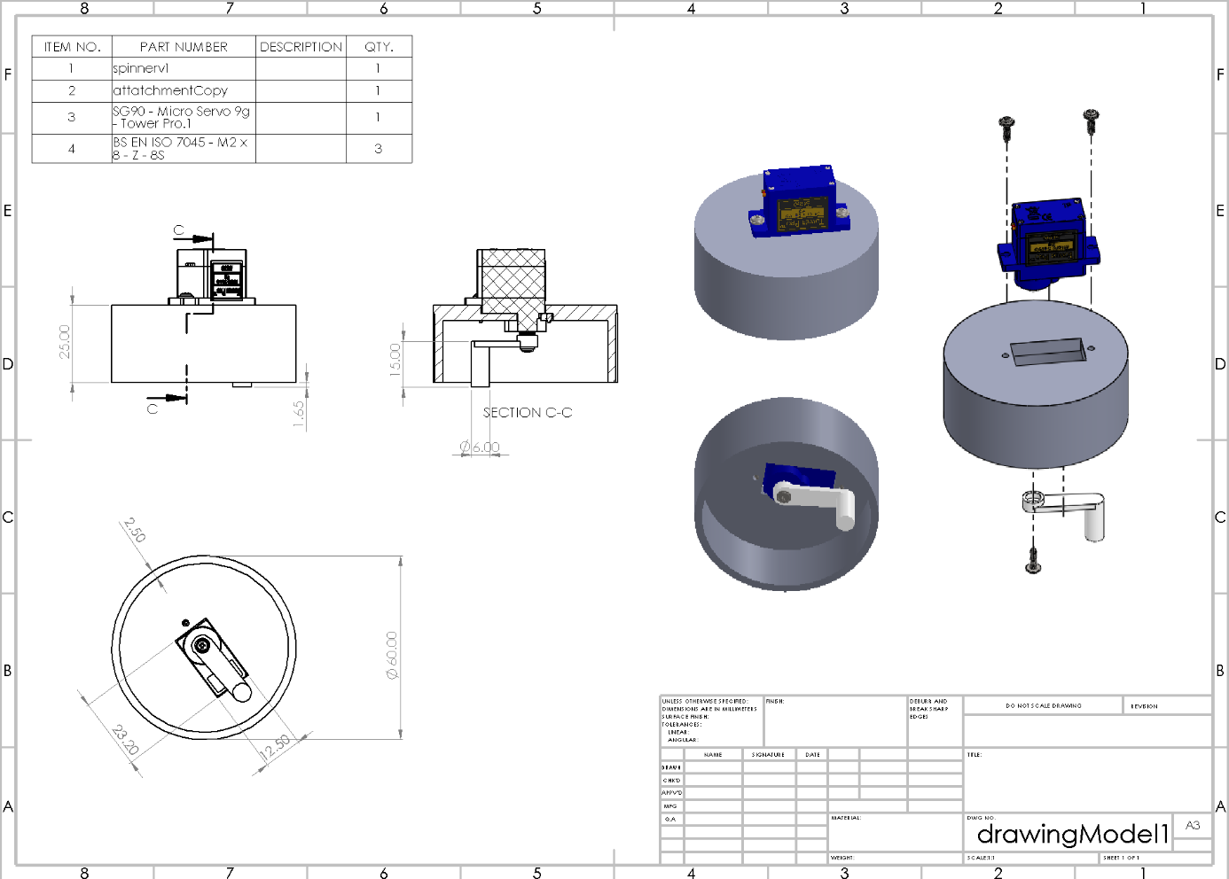
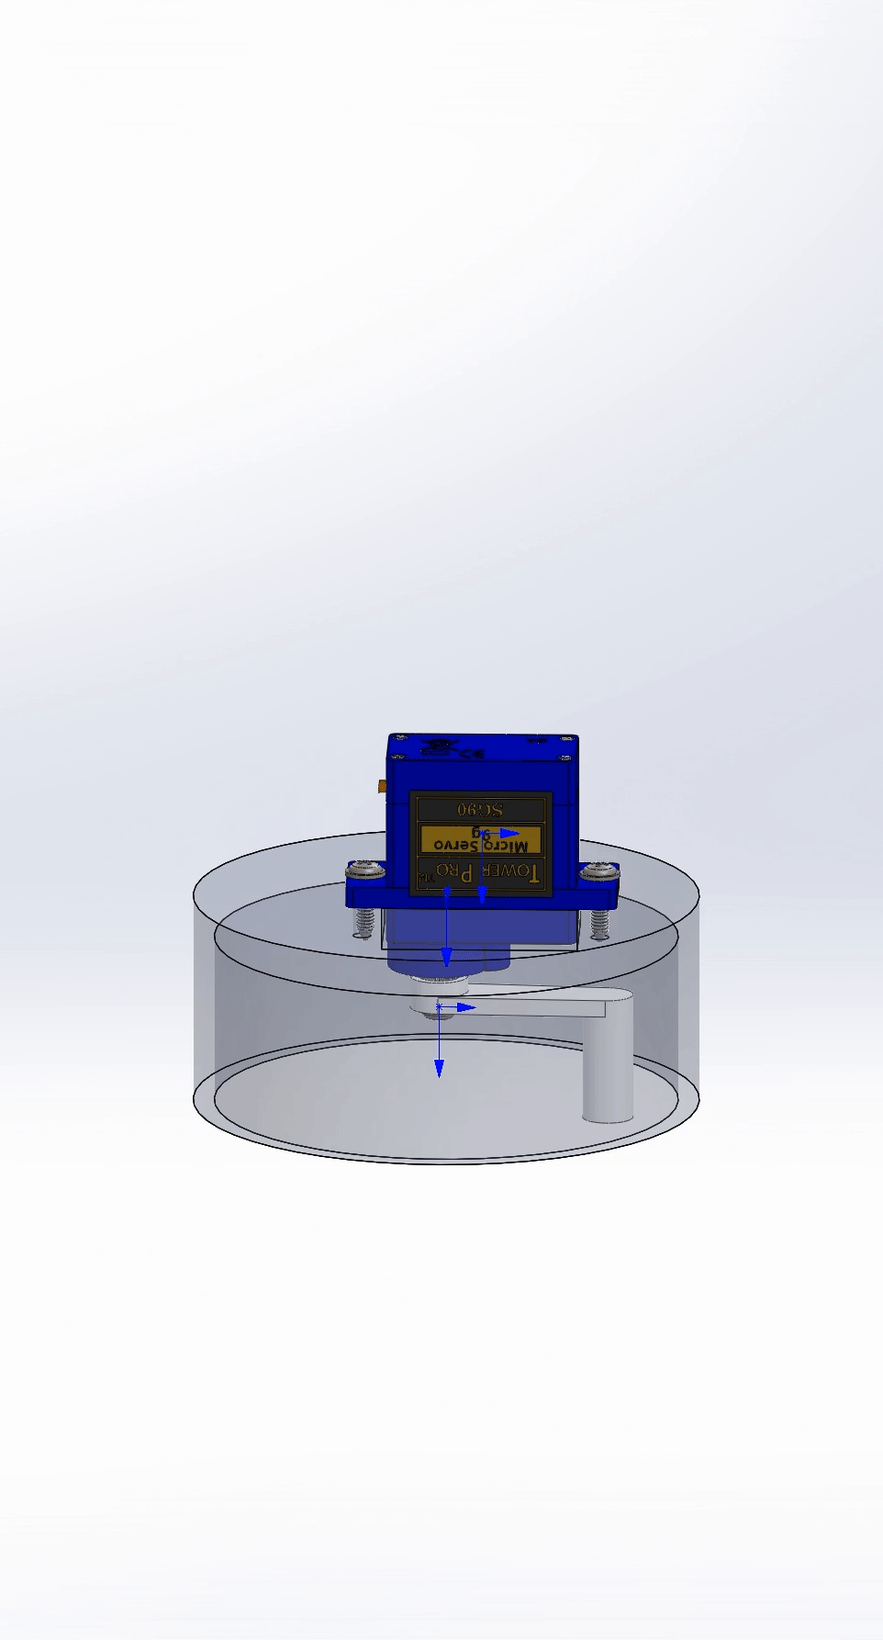
Hardware Update

Slide 23
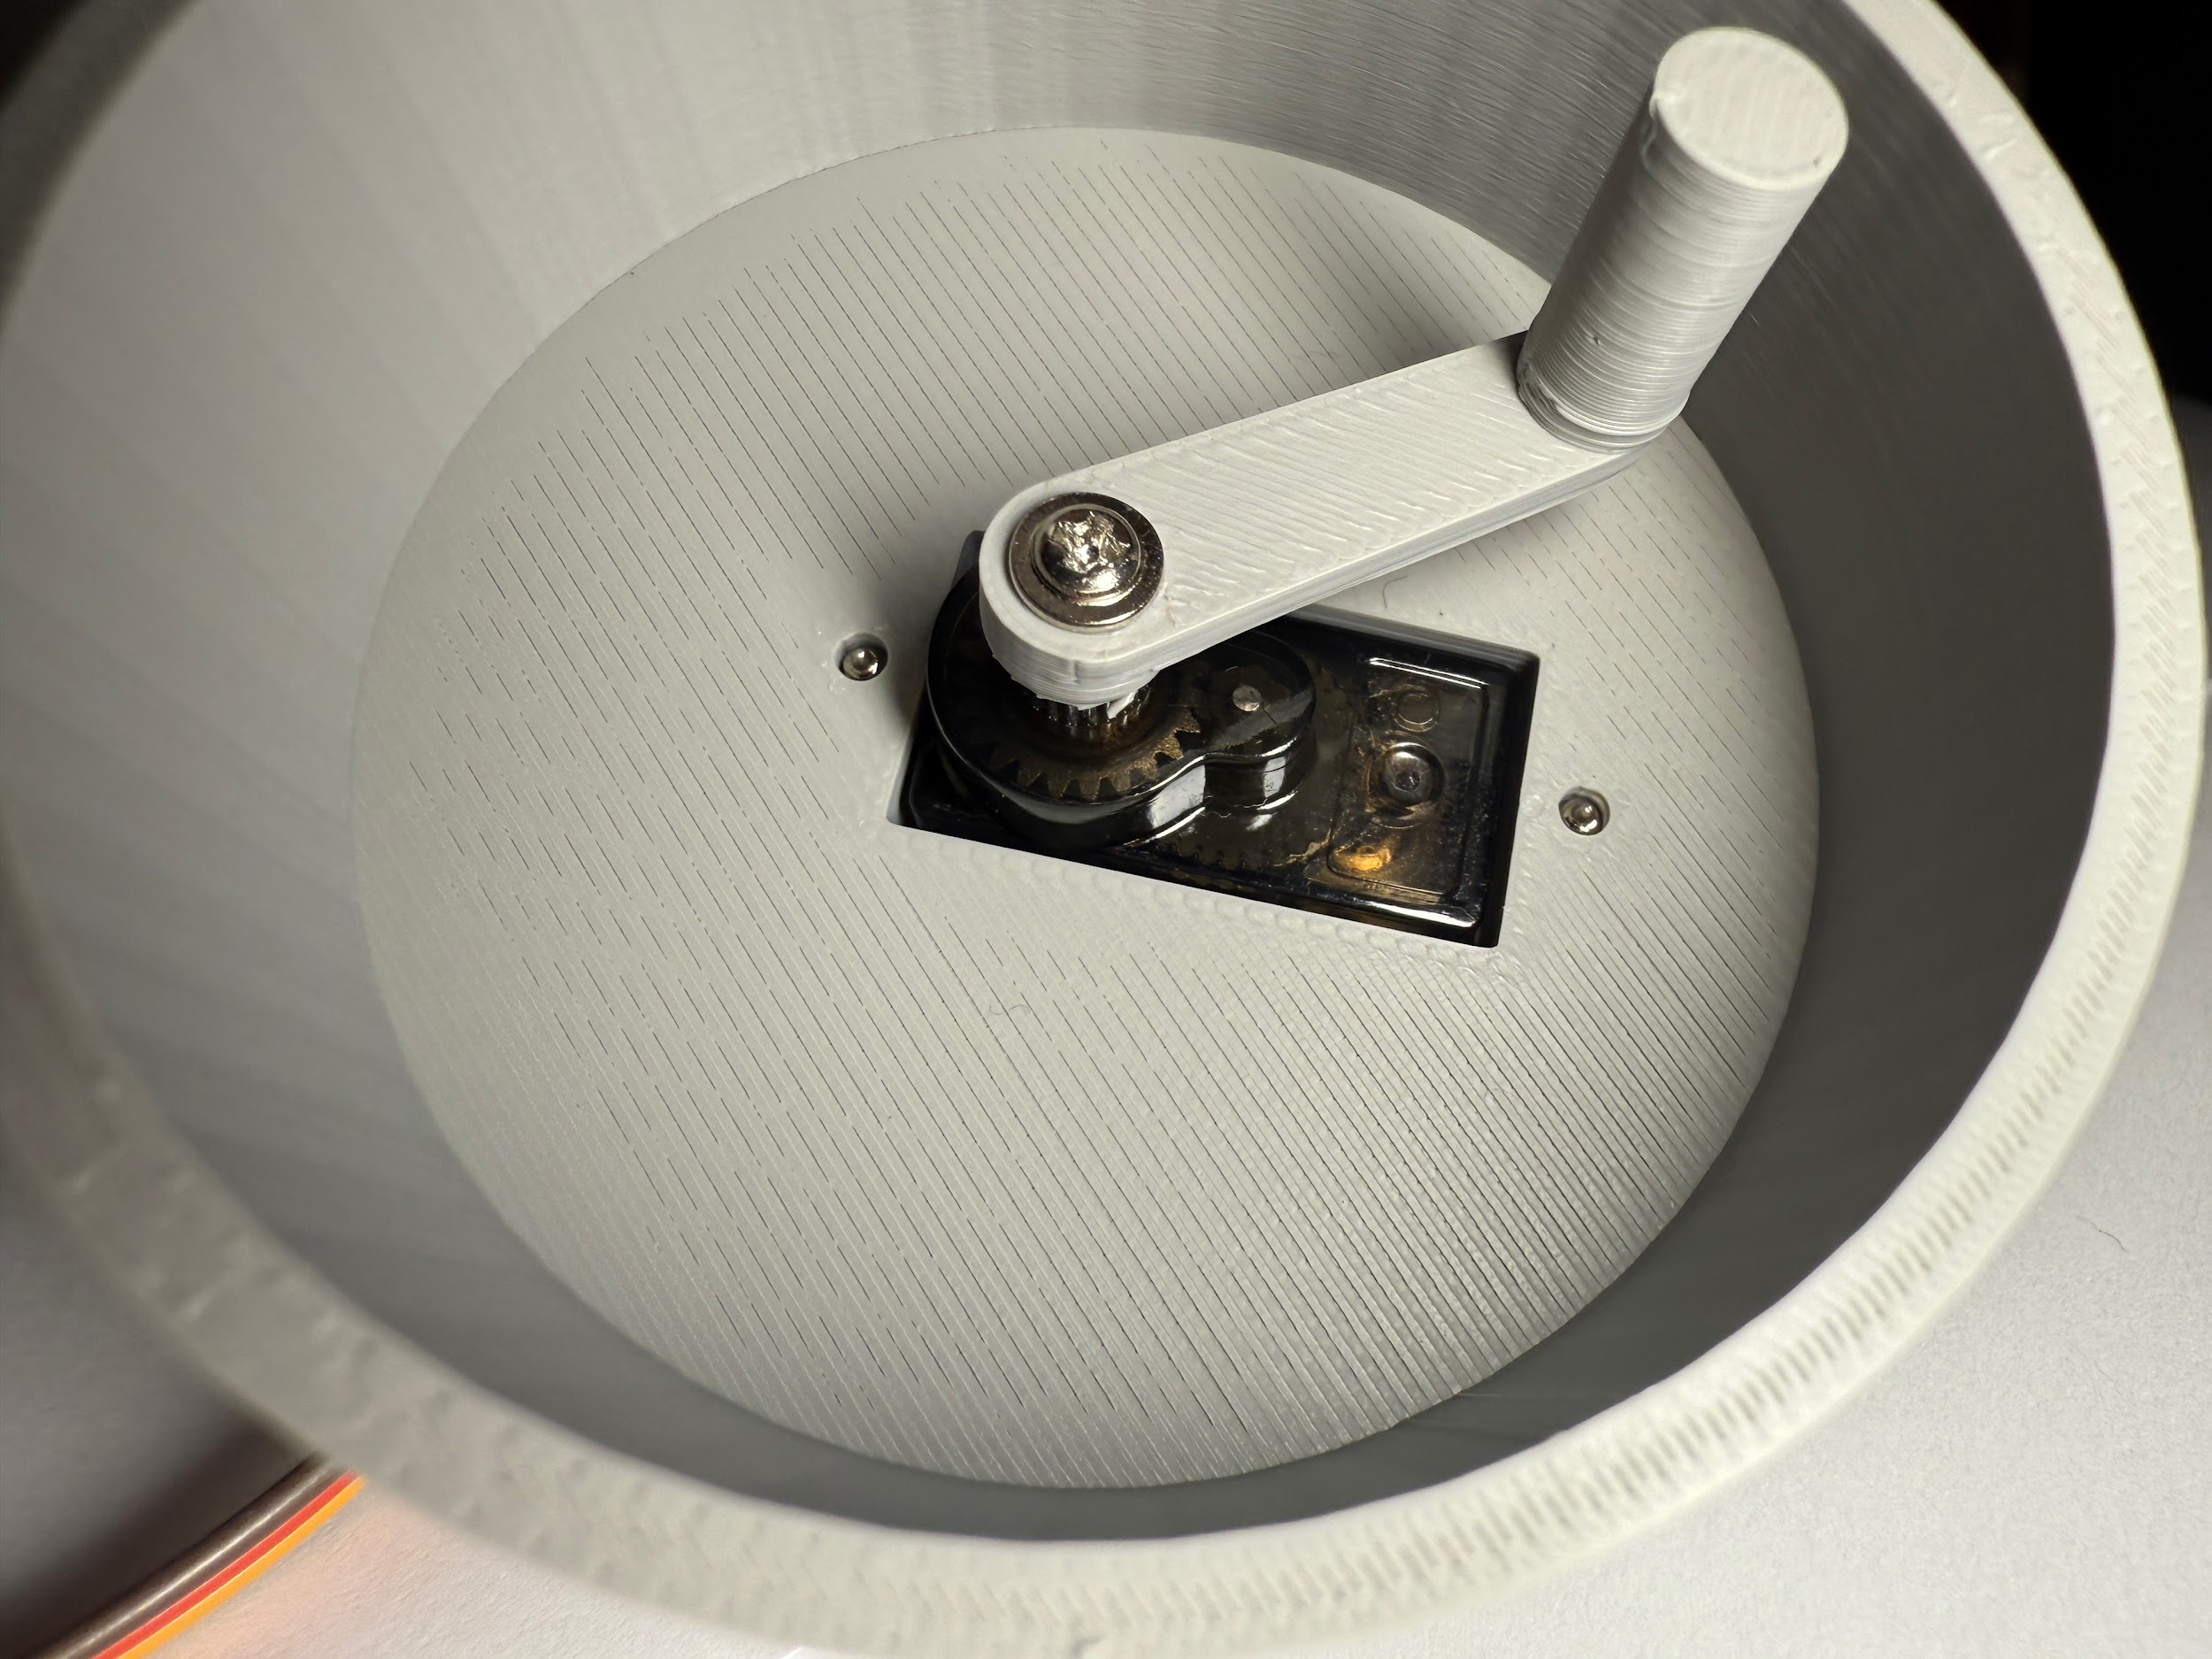
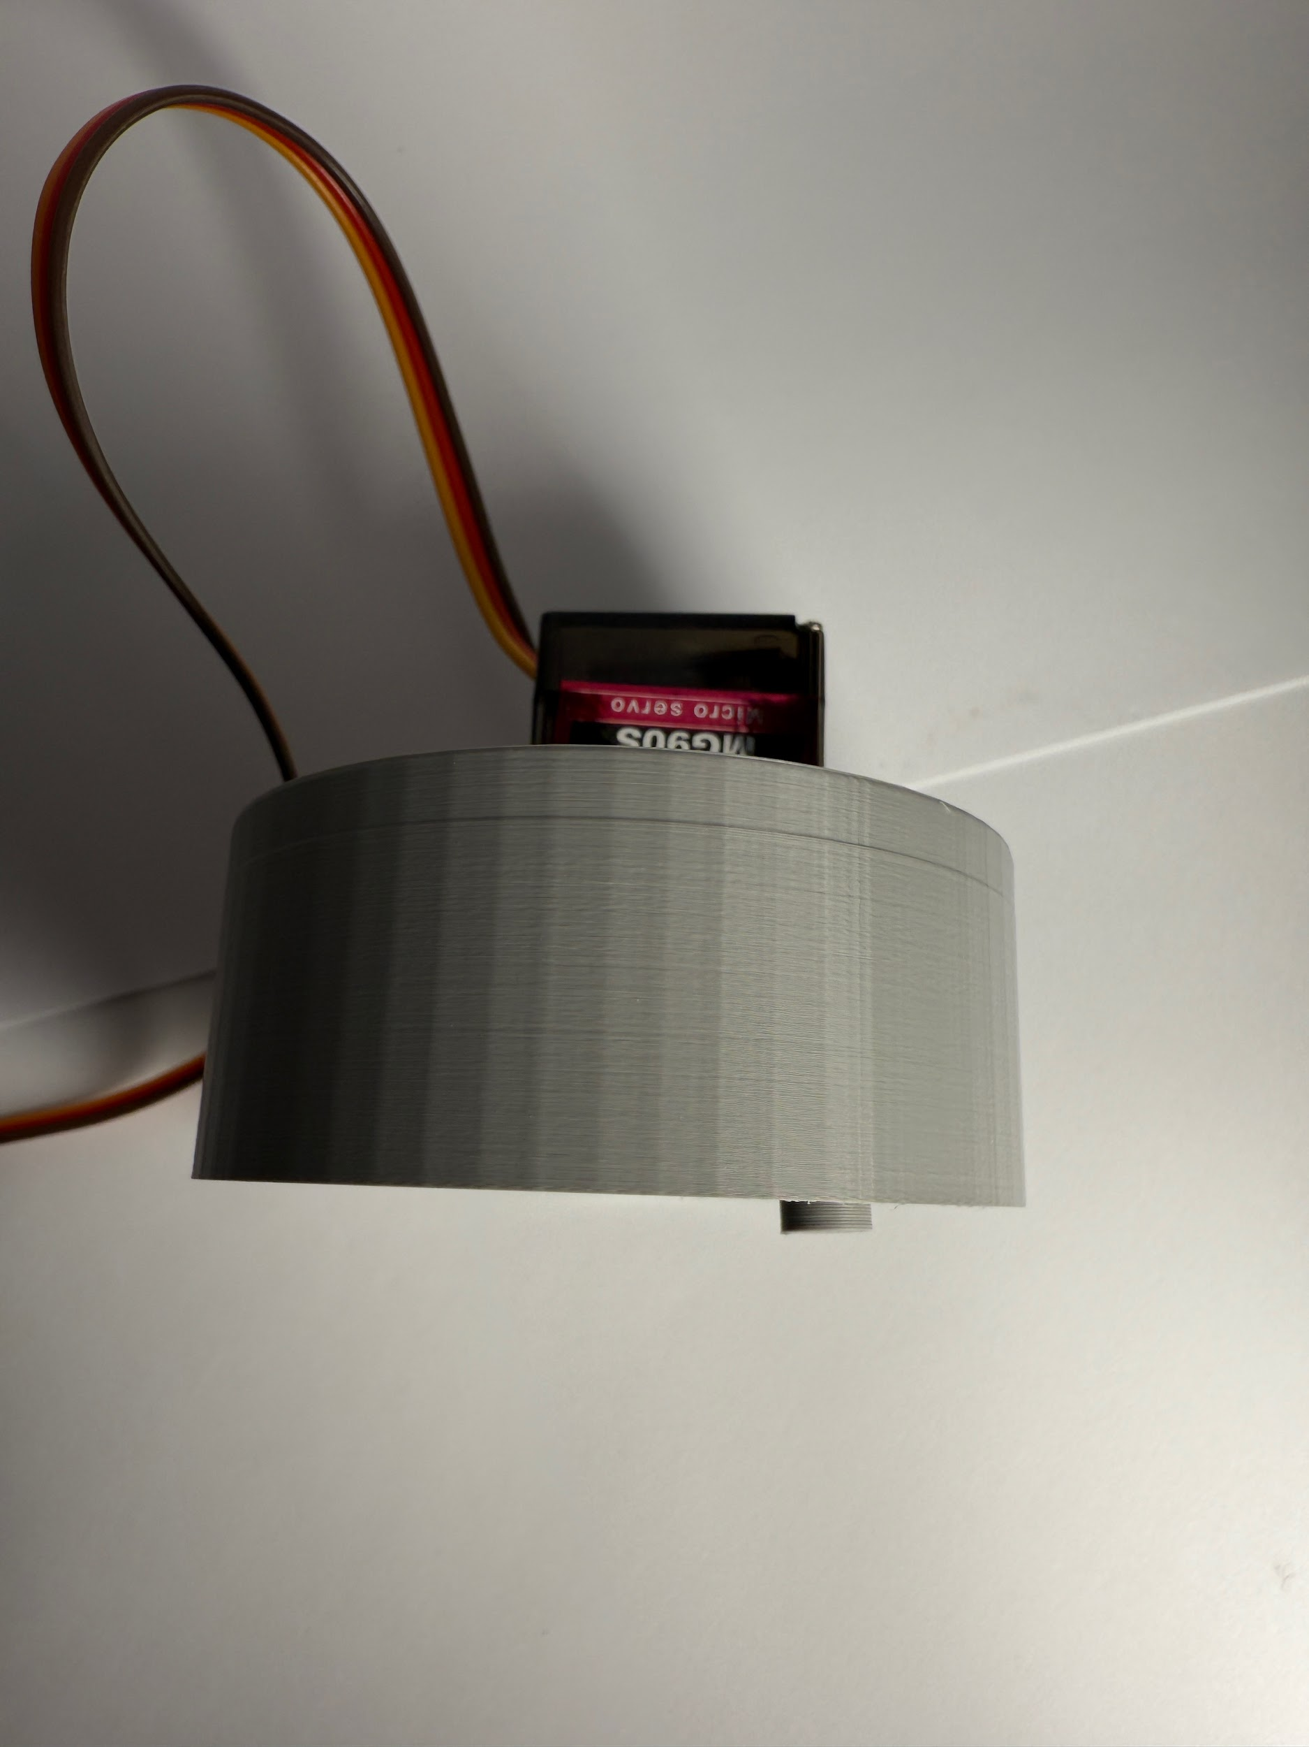
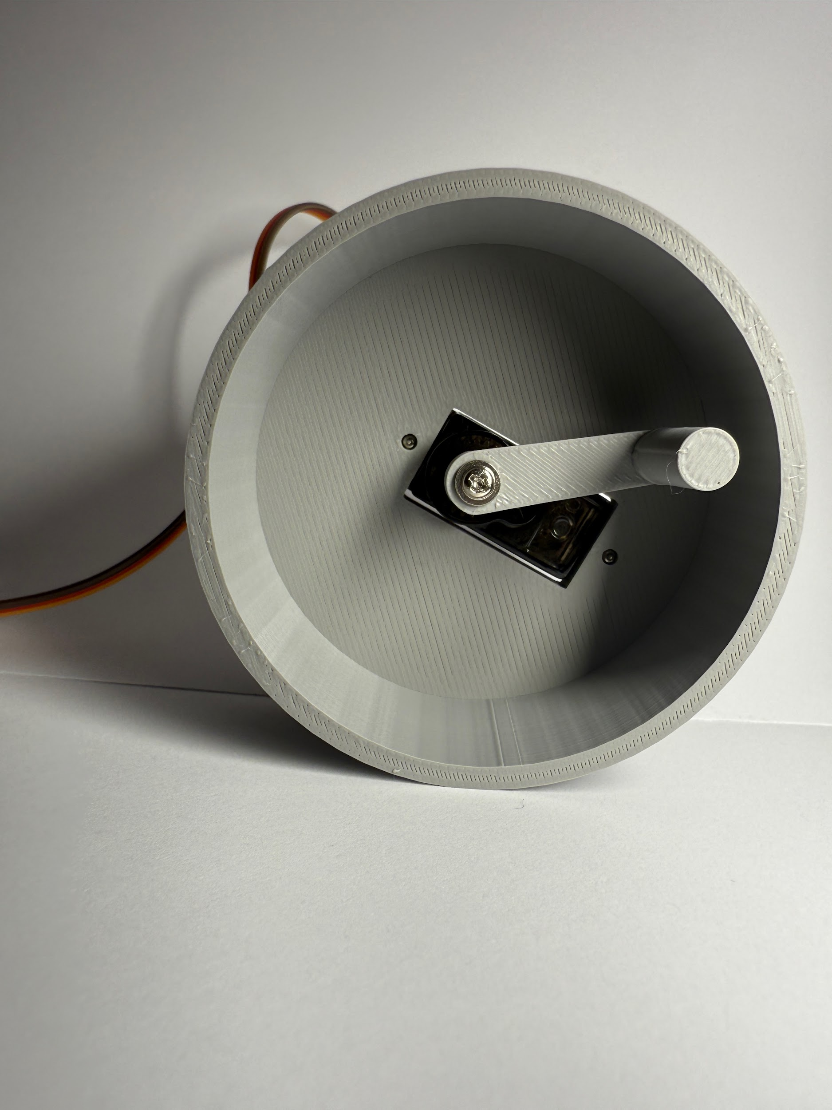
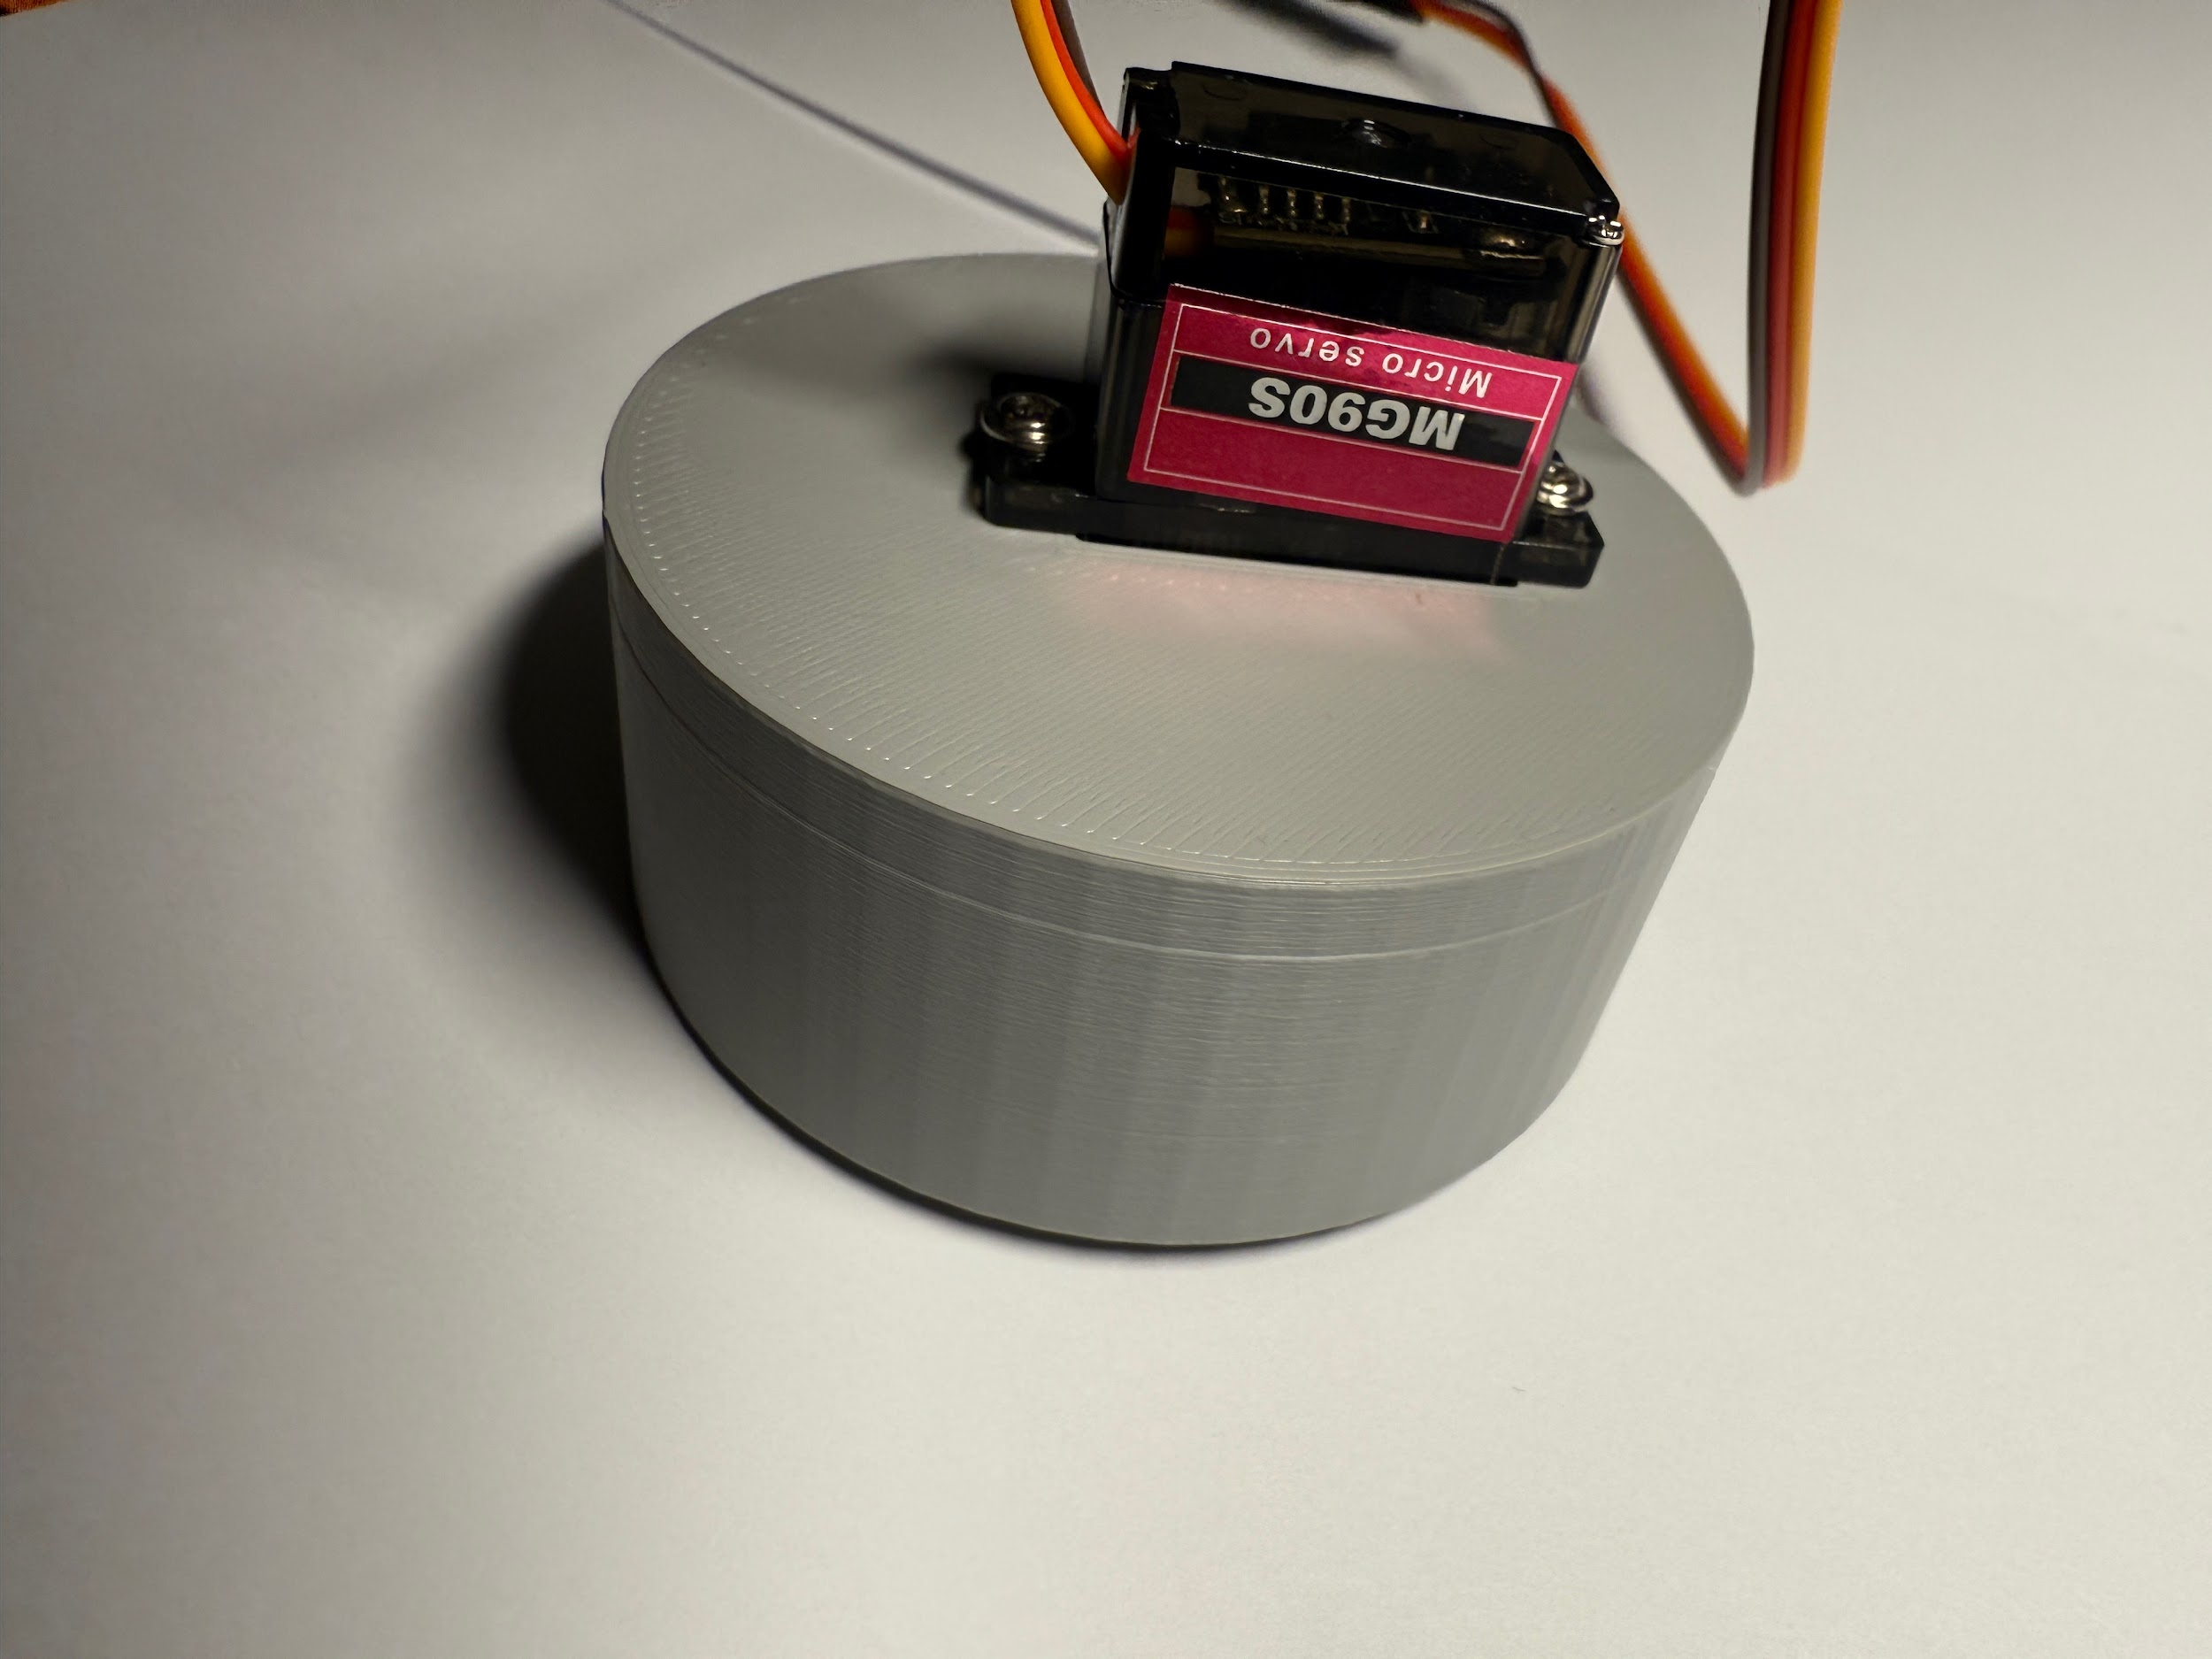
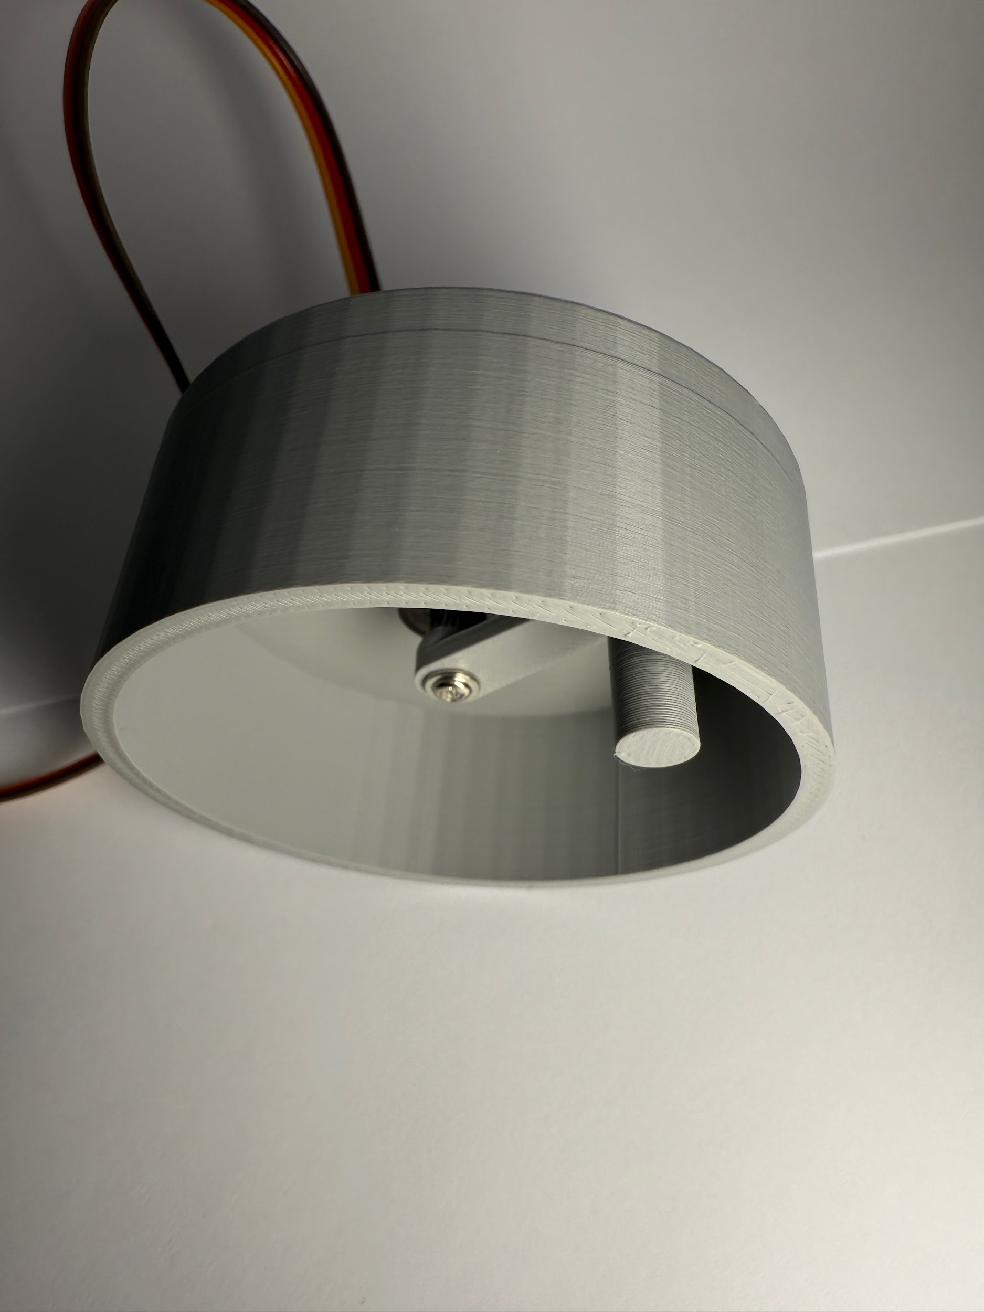
Hardware Update

Slide 24
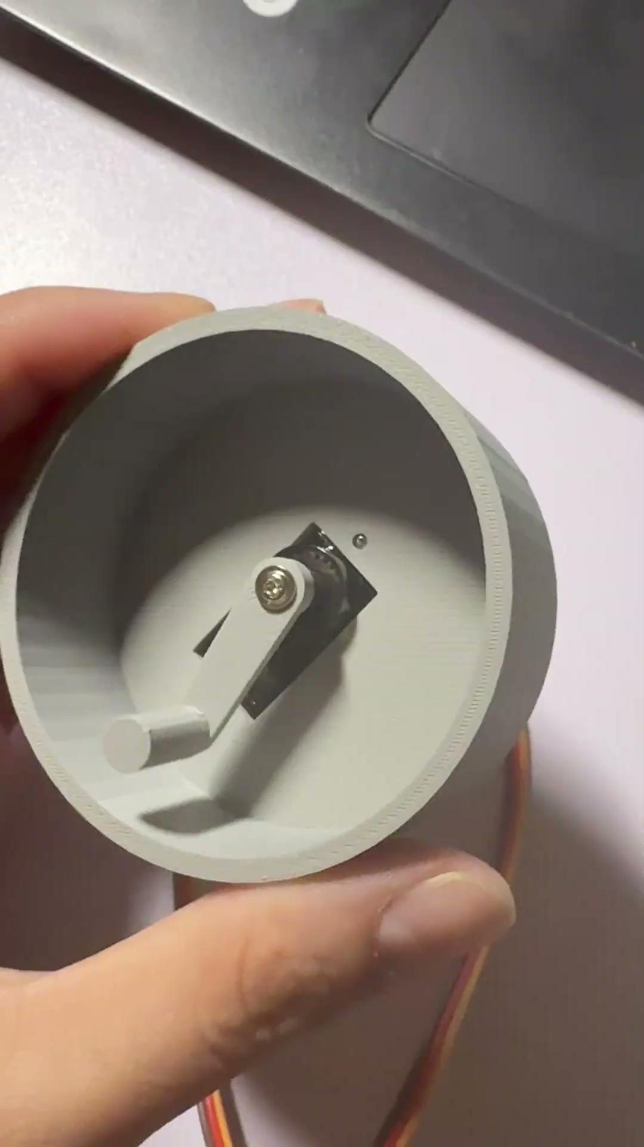
Hardware Update

Slide 25
Versioning Logic
Show depots of generated versions

Slide 26
Versioning Logic
Prerequisites: Apple Developer Membership
General Steps:
Upload Build on TestFlight
Add internal testers
Obtain Feedback
Publish on App Store

Slide 27
Versioning Logic
Upload Build to TestFlight
Upload to App Store Connect (Distribution Files)
Adding Test Details
Adding Test Information
Distribution Files Will Be Tracked Using GitHub
Our distribution will be versioned as follows:
Major.Minor.Change (Github Hash)
Major (X.0.0): Significant changes that may introduce breaking changes
Minor (X.Y.0): New features that are backward-compatible
Change (X.Y.Z): Small patches, Bug Fixes

Slide 28
Next Steps
What the Team Plans to Focus on Next

Slide 29
Next Steps
Refining Prototypes
Improve accuracy and performance of key features
Integration between hardware and software for seamless communication
Potentially have different color options for users for the hardware device (include customization options)
Conducting Usability Testing
Collaborate with visually impaired users to test system in real-world scenarios
Gather insights on the user experience, accessibility, and effectiveness of navigation assistance
Use feedback to refine both hardware and software components

Slide 30





Thank you!
Any Questions?

